Slide 1

50.039 Theory and Practice of Deep Learning W3-S1 Introduction to Deep Learning using the PyTorch framework
Matthieu De Mari

Slide 2
About this week (Week 3)
XXX

Slide 3

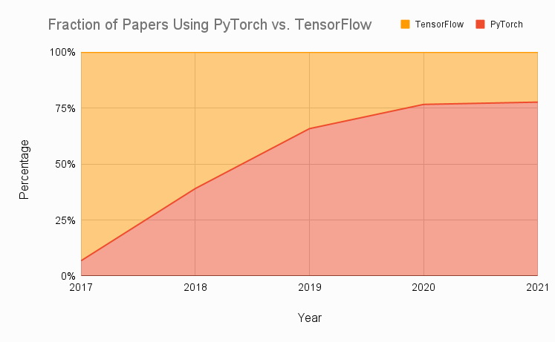
Technical pre-requisites
Framework of choice will be PyTorch! (not Tensorflow, not Keras, not MXNet, etc.)
Increasing popularity and preferred to Google’s Tensorflow these days for many reasons.
Learn more, if curious: https://www.assemblyai.com/blog/pytorch-vs-tensorflow-in-2022/

Slide 4
On the benefits of using PyTorch
There are several benefits to using PyTorch over NumPy for implementing neural networks:
More intuitive interface for working with tensors and neural networks.
NumPy is primarily a numerical computing library.
PyTorch is specifically designed with deep learning, and provides a more natural and convenient interface.
Large active community of users.
Many tutorials, detailed documentations and implementations on Github.
Stack overflow equivalent.
PyTorch has better support for GPU acceleration than NumPy.
If a GPU is available, significantly speed up the training of our neural network by performing the computations on the GPU using PyTorch.
Especially useful for training large and complex models.
High-level abstractions for building and training neural networks.
Easier to write and debug code,
Improve the performance of our model by allowing PyTorch to apply optimization techniques
More specifically, automatic differentiation!

Slide 5
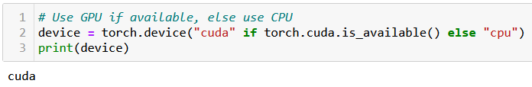
At this point, you should have installed PyTorch, and if possible, CUDA
You can check for CUDA/GPU capabilities, using the line below. If the CUDA has not been properly installed or the GPU is not compatible, you will be using a CPU instead.
We strongly advise to take a moment to make sure your machine is CUDA enabled, assuming your GPU is compatible. When CUDA is properly installed on a compatible GPU, the line below should display cuda, otherwise it will print cpu.

Slide 6
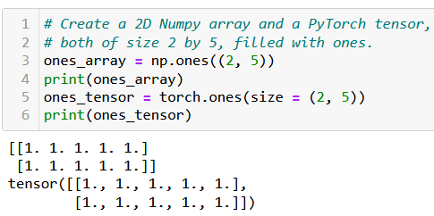
The Tensor object
Definition (Tensor):
The tensor is PyTorch's basic building block and is similar to NumPy arrays.
This is why most of the concepts and methods will look similar
However, these come with additional features, which will be useful later on when building Neural Networks with these tensors.

Slide 7
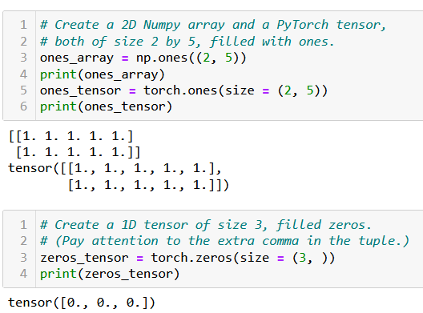
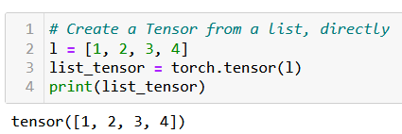
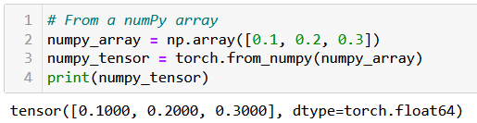
Creating a Tensor
Tensors can be simply created as in NumPy, by using zeros() or ones() functions, specifying dimensions of the expected Tensor, with tuples.
They can also be created from a list (of lists) of values, by passing it to the tensor() function.
Or from a Numpy array, using the from_numpy() method.

Slide 8
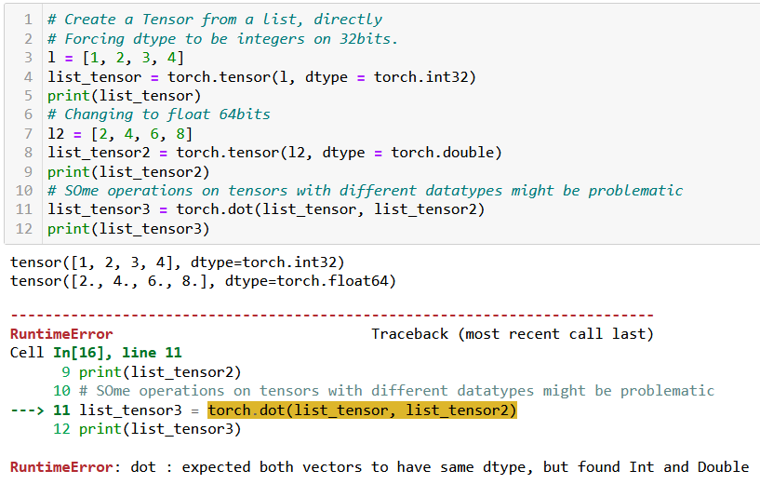
Tensor datatypes (dtypes)
Definition (dtypes):
PyTorch tensors have an attribute called dtype, which tracks the datatype of values stored in the tensor.
See link below for more details on the possible dtypes. https://www.tensorflow.org/api_docs/python/tf/dtypes
In general, operations between tensors require compatible, and sometimes identical dtypes.
Here, the dot product failed because one tensor was int, and the other was float/double.

Slide 9
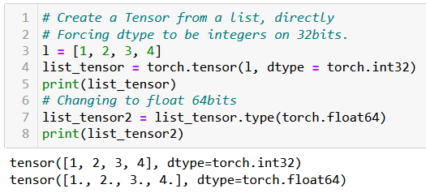
Tensor datatypes (dtypes)
Definition (dtypes):
PyTorch tensors have an attribute called dtype, which tracks the datatype of values stored in the tensor.
See link below for more details on the possible dtypes. https://www.tensorflow.org/api_docs/python/tf/dtypes
In general, operations between tensors require compatible, and sometimes identical dtypes.
You can change the dtype of a tensor
- by either specifying it explicitly during its creation;
- or by using the type() method on the tensor, casting a new dtype.

Slide 10
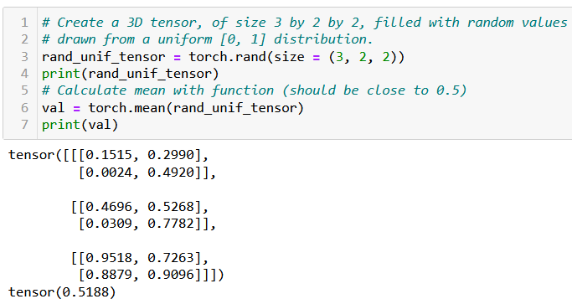
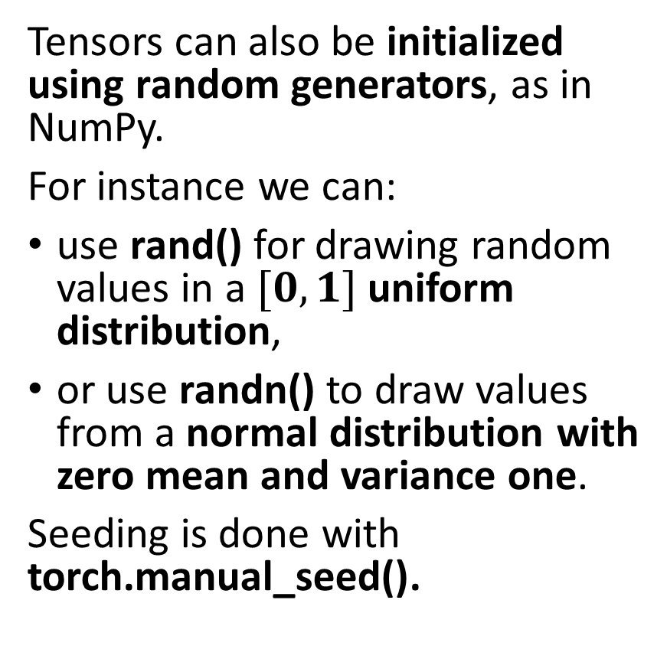
Tensor random initializers
Tensors can also be initialized using random generators, as in NumPy.
For instance we can:
use rand() for drawing random values in a $[0, 1]$uniform distribution,
or use randn() to draw values from a normal distribution with zero mean and variance one.
Seeding is done with torch.manual_seed().
Functions and methods exist for calculating mean values of a tensor, its standard deviation/variance, etc.

Slide 11
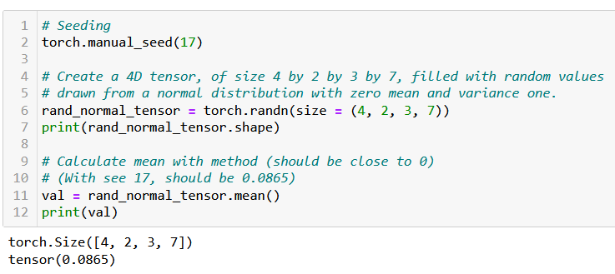
Tensor random initializers
Tensors can also be initialized using random generators, as in NumPy.
For instance we can:
use rand() for drawing random values in a $[0, 1]$uniform distribution,
or use randn() to draw values from a normal distribution with zero mean and variance one.
Seeding is done with torch.manual_seed().
Functions and methods exist for calculating mean values of a tensor, its standard deviation/variance, etc.

Slide 12

Additional attributes of Tensors
Tensors come with many attributes and methods, e.g. asking the shape of a tensor, like in NumPy, is done using the shape attribute.

Slide 13
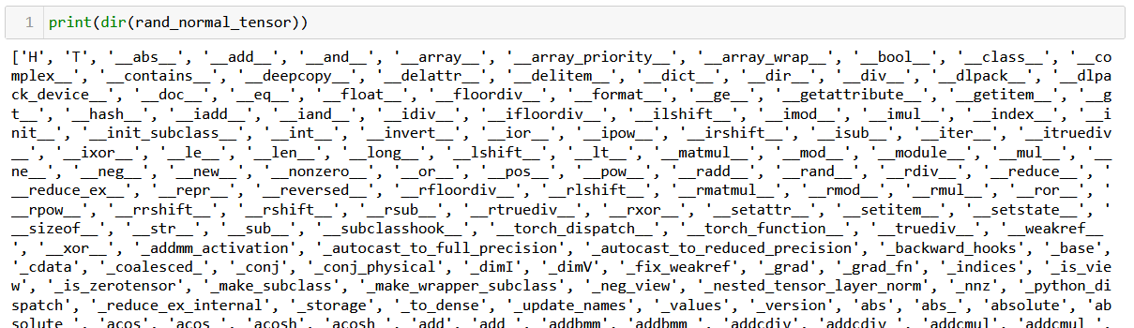
Additional attributes of Tensors
Tensors come with many attributes and methods, e.g. asking the shape of a tensor, like in NumPy, is done using the shape attribute.
Too many of them for me to cover, so RTFM!

Slide 14
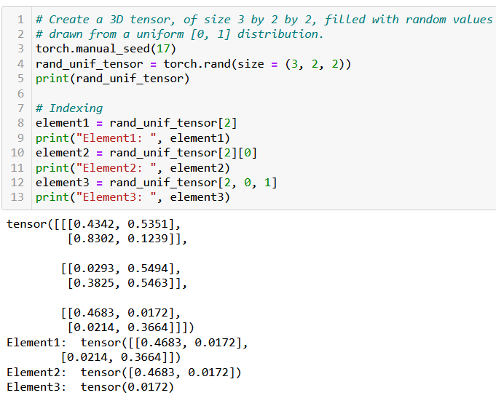
Basic operations on Tensors
All the typical element-wise operations work on tensors. For instance, we can:
access elements using the square bracket notation, multiple square bracket notations and multiple indexes in a single square bracket;
slice a tensor using the square bracket notation and colon symbol;
update elements of a tensor using the square bracket notation;
browse through elements of a tensor using a for loop.

Slide 15
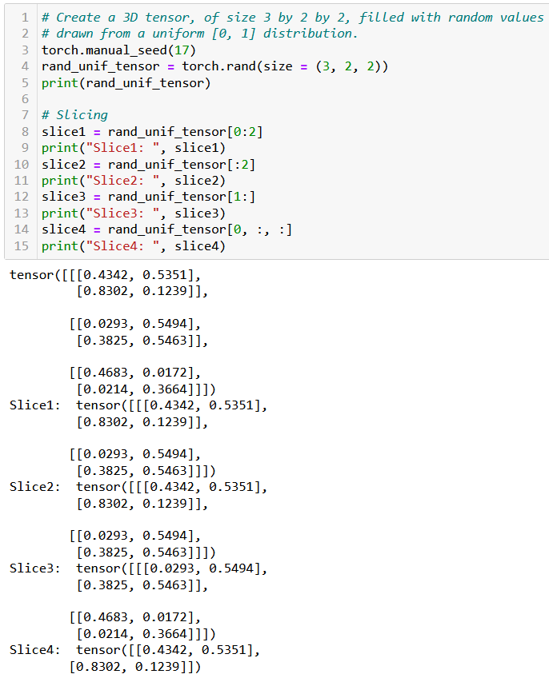
Basic operations on Tensors
All the typical element-wise operations work on tensors. For instance, we can:
access elements using the square bracket notation, multiple square bracket notations and multiple indexes in a single square bracket;
slice a tensor using the square bracket notation and colon symbol;
update elements of a tensor using the square bracket notation;
browse through elements of a tensor using a for loop.

Slide 16
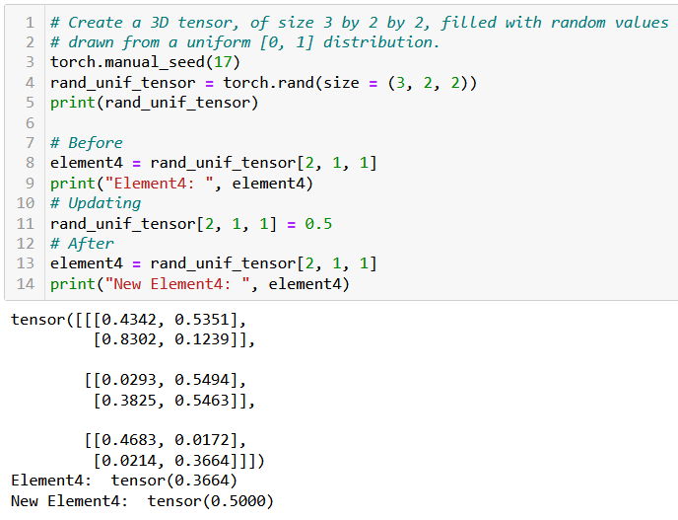
Basic operations on Tensors
All the typical element-wise operations work on tensors. For instance, we can:
access elements using the square bracket notation, multiple square bracket notations and multiple indexes in a single square bracket;
slice a tensor using the square bracket notation and colon symbol;
update elements of a tensor using the square bracket notation;
browse through elements of a tensor using a for loop.

Slide 17
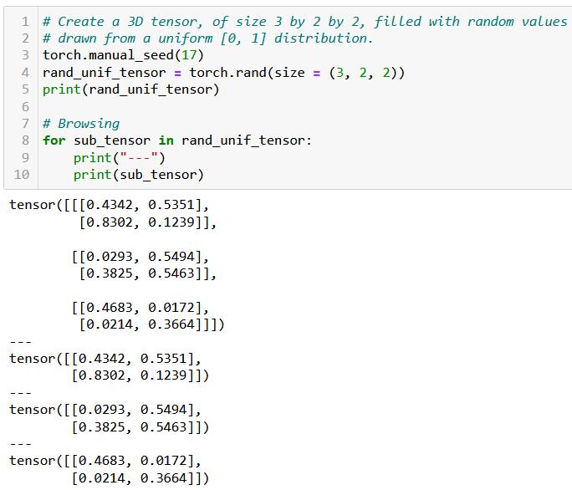
Basic operations on Tensors
All the typical element-wise operations work on tensors. For instance, we can:
access elements using the square bracket notation, multiple square bracket notations and multiple indexes in a single square bracket;
slice a tensor using the square bracket notation and colon symbol;
update elements of a tensor using the square bracket notation;
browse through elements of a tensor using a for loop.

Slide 18

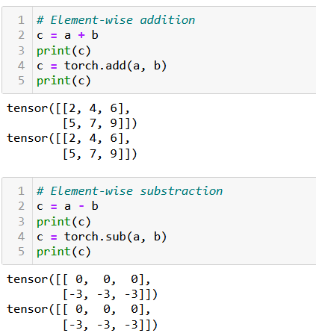
Arithmetic operations on Tensors
All NumPy array operations work on Tensors and equivalent methods have been written in torch as well.
Element-wise Addition/Subtraction,
Element-wise Multiplication/Division,
Transposition,
Matrix multiplication and dot product,
Etc.

Slide 19
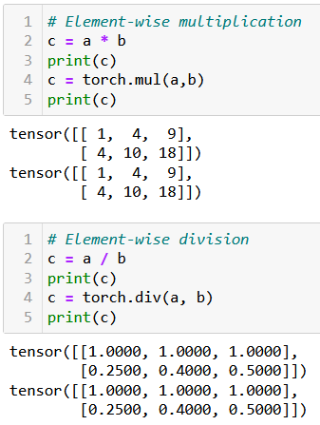
Arithmetic operations on Tensors
All NumPy array operations work on Tensors and equivalent methods have been written in torch as well.
Element-wise Addition/Subtraction,
Element-wise Multiplication/Division,
Transposition,
Matrix multiplication and dot product,
Etc.

Slide 20
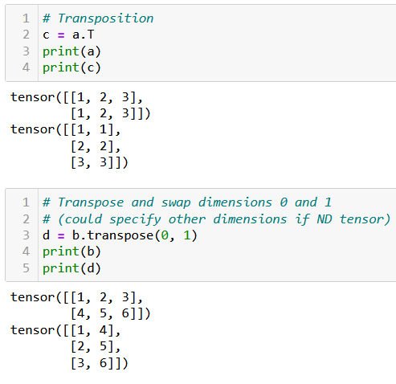
Arithmetic operations on Tensors
All NumPy array operations work on Tensors and equivalent methods have been written in torch as well.
Element-wise Addition/Subtraction,
Element-wise Multiplication/Division,
Transposition,
Matrix multiplication and dot product,
Etc.

Slide 21
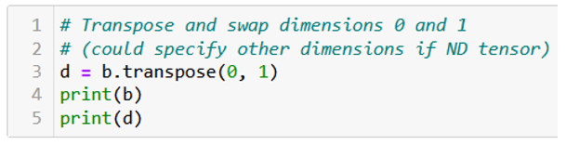
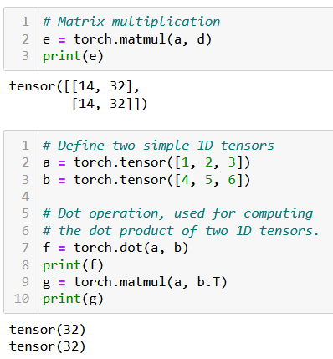
Arithmetic operations on Tensors
All NumPy array operations work on Tensors and equivalent methods have been written in torch as well.
Element-wise Addition/Subtraction,
Element-wise Multiplication/Division,
Transposition,
Matrix multiplication and dot product,
Etc.

Slide 22
A quick note on broadcasting
Tensors, just like NumPy arrays, support broadcasting.
Two tensors are “broadcastable” if the following rules hold:
Each tensor has at least one dimension.
When iterating over the dimension sizes, starting at the trailing dimension, the dimension sizes must either be equal, one of them is 1, or one of them does not exist.
If two tensors x, y are “broadcastable”, the resulting tensor size is calculated as follows:
If the number of dimensions of x and y are not equal, prepend 1 to the dimensions of the tensor with fewer dimensions to make them equal length.
Then, for each dimension size, the resulting dimension size is the max of the sizes of x and y along that dimension.

Slide 23
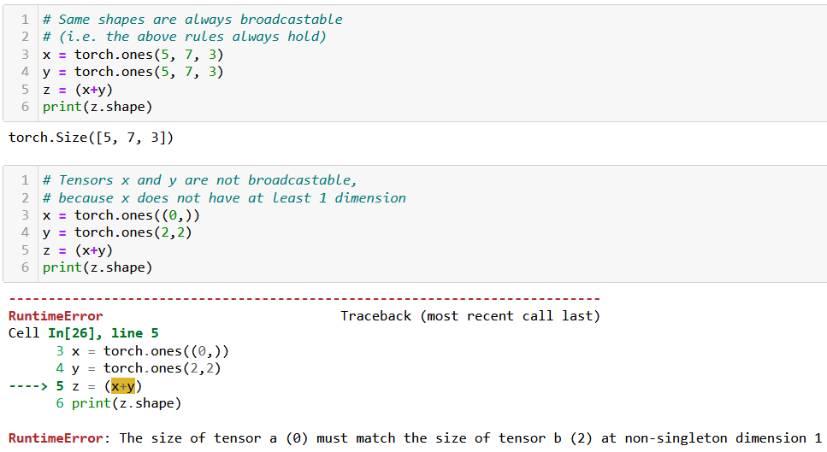
A quick note on broadcasting

Slide 24
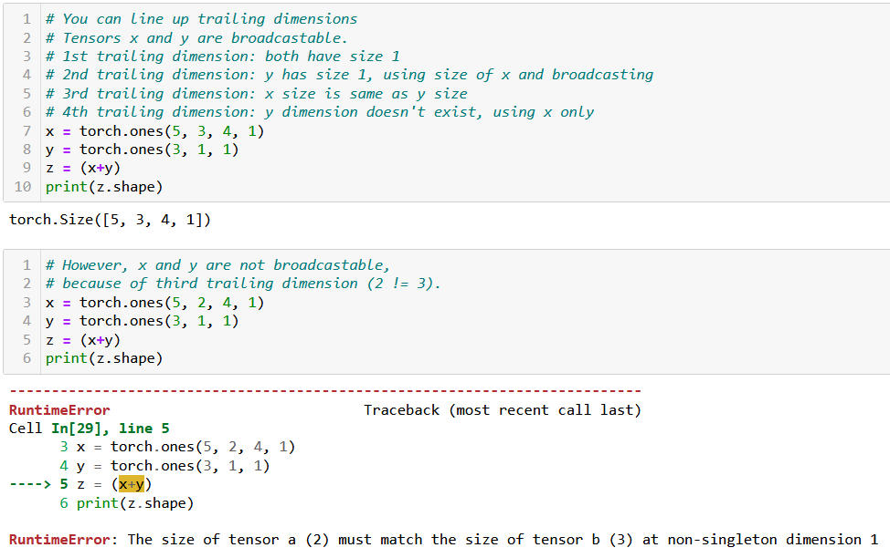
A quick note on broadcasting

Slide 25

Tensor locations
Recall: PyTorch has better support for GPU acceleration than NumPy.
If a GPU is available, significantly speed up the training of our neural network by performing the computations on the GPU using PyTorch.
Especially useful for training large and complex models.

Slide 26
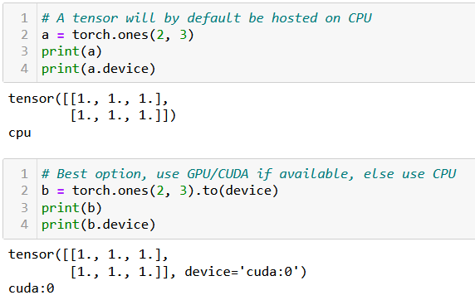
Tensor locations
By default, all tensors are used by the CPU. If device enabled for GPU/CUDA computation, transfer the tensor to the GPU for faster computation.
This is done in three ways:
Using .to(device) method will transfer to the best device available for computation (device variable defined earlier, when we checked for cuda/cpu).
Using .cpu() or .cuda() will force transfer to the cpu or cuda respectively. Note that it might fail if you machine is not CUDA compatible.

Slide 27
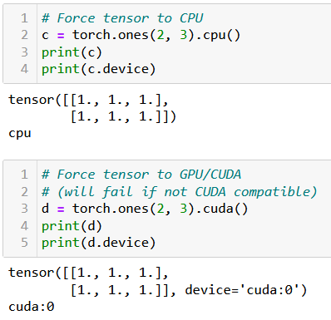
Tensor locations
By default, all tensors are used by the CPU. If device enabled for GPU/CUDA computation, transfer the tensor to the GPU for faster computation.
This is done in three ways:
Using .to(device) method will transfer to the best device available for computation (device variable defined earlier, when we checked for cuda/cpu).
Using .cpu() or .cuda() will force transfer to the cpu or cuda respectively. Note that it might fail if you machine is not CUDA compatible.

Slide 28
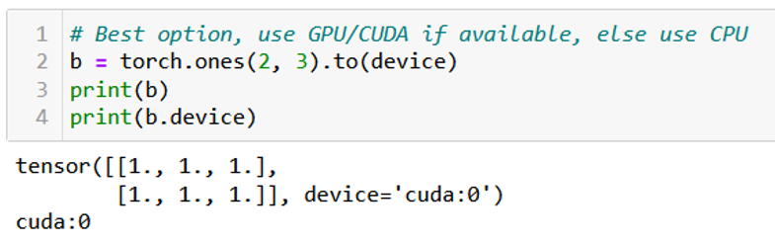
Tensor locations
By default, all tensors are used by the CPU. If device enabled for GPU/CUDA computation, transfer the tensor to the GPU for faster computation.
This is done in three ways:
Using .to(device) method will transfer to the best device available for computation (device variable defined earlier, when we checked for cuda/cpu).
Using .cpu() or .cuda() will force transfer to the cpu or cuda respectively. Note that it might fail if you machine is not CUDA compatible.
In doubt, you can check the device attribute of your tensors to find where their computations will occur.

Slide 29
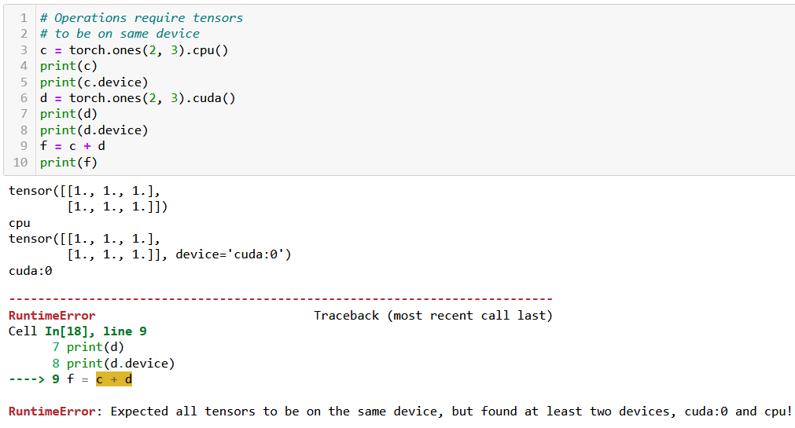
Tensor locations
Keep in mind: two tensors with different devices cannot be used in the same operation! (same logic as dtypes).

Slide 30
A bit of practice for you to try at home
In order to practice your PyTorch Tensor skills, you may try to manually implement your own version of typical algorithms we ran on lists/Numpy arrays in previous classes, using the basic operations on PyTorch tensors.
For instance, try writing algorithms:
Finding the maximum, minimum, average, median values of a given 1D tensor,
Transposing a given 2D tensor,
Sorting a given 1D tensor (bubble sort, insertion sort, selection sort, quick sort, merge sort),
Generating a 1D array containing the first K Fibonacci numbers with K given,
Etc.
Later, you can check their performance times compared to their numpy/pytorch implementations when running them on both CPU and CUDA (if available).
In which scenarios is it slower to implement said functions and run them on GPU?

Slide 31
Class, nn.module, init, retain grad

Slide 47
Dataset, softmax on predictions

Slide 52
Conclusion (Week 3)
XXX
XXX

Slide 53
Learn more about these topics
Out of class, supporting papers, for those of you who are curious.
[XXX] XXX

Slide 54
Learn more about these topics
Some extra (easy) reading and videos for those of you who are curious.
[XXX] XXX

